Slide 1
Understanding the new lcap template and the demonstration of increased or improved services for pupils
The views and opinions expressed in this presentation are those of the authors and do not
necessarily reflect those of CASBO.

Slide 2
Presenters
Donna Ellis, Supervisor, District Financial Services, Fresno COE
Catherine Hawes, Coordinator III, External Business Services, Sutter County Supt. of Schools
Jennifer Stahlheber, Director, External Business Services, Sutter County Supt. of Schools

Slide 3
Agenda
New Section Order for LCAP
Plan Summary
Plan Summary-Budget Summary
Annual Update
Stakeholder Engagement
Goals, Actions, and Services
Demonstration of Increased or Improved Services for Unduplicated Pupils

Slide 4
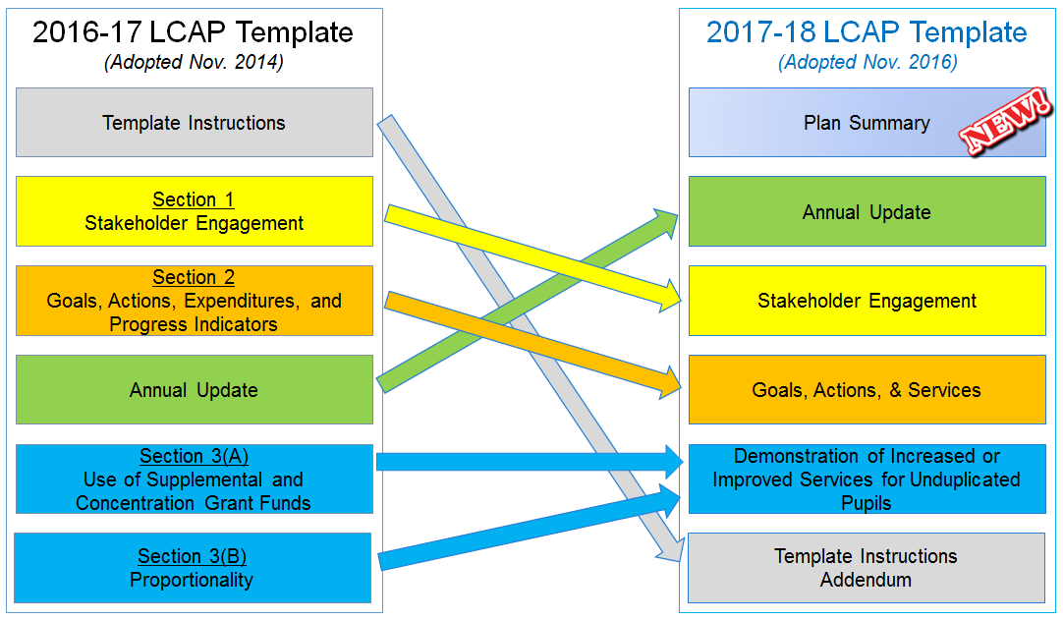
LCAP Template Crosswalk
2017 CASBO Annual Conference & California School Business Expo

Slide 5
What are the expectations in a 3-year inclusive plan?
LCAP Components | Year 1 | Year 2 | Year 3
Plan Summary | Yearly | Yearly | Yearly
Budget Summary | Yearly | Yearly | Yearly
Annual Update | Yearly | Yearly | Yearly
Stakeholder Engagement | Yearly, no historical narrative to be kept | Yearly, no historical narrative to be kept | Yearly, no historical narrative to be kept
Goals, Actions, & Services | Written for 3 years | Changes to plan could include a change to a specific goal, adding an action, modifying an action, discontinuing an action - all based on review of data/metrics and indicators
Demonstration of Increased/Improved Services | Yearly, historical context kept over 3 years | Yearly, historical context kept over 3 years | Yearly, historical context kept over 3 years
2017 CASBO Annual Conference & California School Business Expo
Notes:
We are moving to what we have heard is a 3-year static or inclusive plan. What does this mean in terms of the actual writing of the template. We know that a new 3rd year out of the plan will not need to be created every year, but what else does this mean?

Slide 6
Section 1: Plan Summary
2017 CASBO Annual Conference & California School Business Expo

Slide 7
2017-20 Plan Summary
New Section
In addition to streamlining the LCAP process for the LEAs, making the development process and the LCAP accessible to all stakeholders were factors in the latest revision of the LCAP template and also led to the “Plan Summary” as a requirement of the template.
Parent groups, advocates and practitioners made their voices heard regarding the need for improved accessibility of the plans.
From this:
Introduction:
LEA: ___ Contact Person ___ LCAP Year ___
To this:
2017 CASBO Annual Conference & California School Business Expo
Notes:
Have you seen the video of Building an Airplane in the Sky? If not it is worth a look on Youtube it has been around for years and I’ve often felt it described our work in schools. The idea of building the plane while flying has become even more applicable in the age of LCFF, moving toward a continuous cycle of improvement with data analysis, stakeholder engagement, planning, alignment of resources, and implementation often happening concurrently to improve outcomes for all. Our work with LCAP has been dynamic and there have been many changes, at the very beginning as the first template was being developed the word was we would be asked to “Tell Our Story” now we have moved from the Introduction, colon to a plan summary. The summary is a welcome addition to increase accessibility and transparency, as the LCAP continues to evolve into the district - stakeholder agreement it is meant to be …
It was a bit ironic that I am presenting on the summary as working on summaries has been almost a 2nd or rather 6th job for me. Last winter a cross section of local parent and student groups met with our office to talk about LCAP and the problem of access for many parents to the document. They were excited about the promise of LCFF/LCAP but felt that meaningful participation from a large section of the community was limited due to the complexity of the documents. It became my job to search, examine, share, and create a template that could be used by or recommended to our districts. What did the parents want to see in the summary? Probably not surprising that much of what the parents wanted to see is incorporated into the new template. Brief budget summary revenues and expenditures (How much is spent in the LCAP?), brief profile of who the district serves and how they are served; a brief discussion of outcomes, brief summary of key actions, and brief summary of increased or improved services

Slide 8
2017-20 Plan Summary
New section added in response to feedback that LCAPs lacked accessibility and growing pressure from advocacy groups on SBE and growing consensus that providing a summary was a good practice.
Five components:
The Story
LCAP Highlights
Review of Performance
Increased or Improved Services
Budget Summary
2017 CASBO Annual Conference & California School Business Expo
Notes:
The Plan Summary is a key component of accessibility and transparency. It is a key element to develop and share your talking points,It is a vehicle to highlight successes and show how the LEA is addressing its most critical needs for stakeholders and the community….. Read the 5 elements

Slide 9
Plan Summary: Story & Highlights
Brief - a few sentences
Who do you serve? Describe students and community
How is LCAP tied to district vision for student success
List key objectives of LCAP that are aligned with at least 1 of 8 state priorities
2017 CASBO Annual Conference & California School Business Expo

Slide 10
Plan Summary: Story & Highlights Example
Briefly describe the students and community and how the LEA serves them
The Justice for All Unified School District serves a diverse group of students with the goal of: “Preparing every student to thrive in a global society.” Our student population is 51.2% English learner (EL) and 48% are classified as Low Income, our LCFF Unduplicated count is 54.8% and 83% of our EL students speak Spanish, additional languages include Vietnamese, Mandarin, Arabic, Tagalog, Punjab and Hmong. Our student population is made up of many ethnicities with the majority of our students 51% identifying as Hispanic Latino, 28% White, 8% Asian and 5% African American.
We serve approximately 21,000 students Pre-k through 12th grade at 22 quality schools: 4 traditional high schools, 5 middle schools, 2 continuation high schools, 1 alternative school of choice, and 10 elementary schools. The district also authorizes four charter schools that are required to create their own LCAP.
Does this example address the prompt given in the template?
Note: groups reviewing summaries appreciated graphic representations when applicable, not sure if e-template will be compatible with graphics
2017 CASBO Annual Conference & California School Business Expo
Notes:
We prepared this using information from a summary prepared for the 2016 LCAP, names were changed to protect the innocent. At your tables, take a couple of minutes to discuss, does this example address the prompt given in the template?
Ask for any suggestions

Slide 11
Plan Summary: Story & Highlights Example 1
LCAP HIGHLIGHTS
Identify and summarize the key features of this year’s LCAP
This example provides linkage to the goals and where to find more detail within the LCAP.
Working closely with stakeholders throughout the district, five goals have been identified for focus within the next three years.
• GOAL 1 - High-quality academics: JFAUSD will provide a high quality and comprehensive instructional program that produce college and career ready students. 13 Actions/Services (pp. 20-26)
• GOAL 2 - Broader community and family supports: JFAUSD will ensure students, staff, parents and the community are satisfied and engaged in our schools and programs. 9 Actions/Services (pp. 27-29)
• GOAL 3 - Research-based accountability and support: JFAUSD LCAP Goals, Actions and Services will demonstrate efficient and exemplary practices in all divisions, departments and schools. (pp. 30-31)
• GOAL 4 - High-quality staff: JFAUSD will attract, recruit, support and retain a highly effective and diverse certificated, classified and administrative workforce. 4 Actions/Services (pp. 32-33)
• GOAL 5 - Aligned resources/efficient operations: JFAUSD will align resources to the strategic plan and equity policy and demonstrate cost-effective budget management in the allocation of funds. 2 Actions/Services (p. 34)
2017 CASBO Annual Conference & California School Business Expo
Notes:
Example 1 here is also based on example from a district LCAP summary. It provides a clear overview of the LCAP and the major goals, they also appreciated the page references, and getting an overview of the number of actions and services related to each goal.

Slide 12
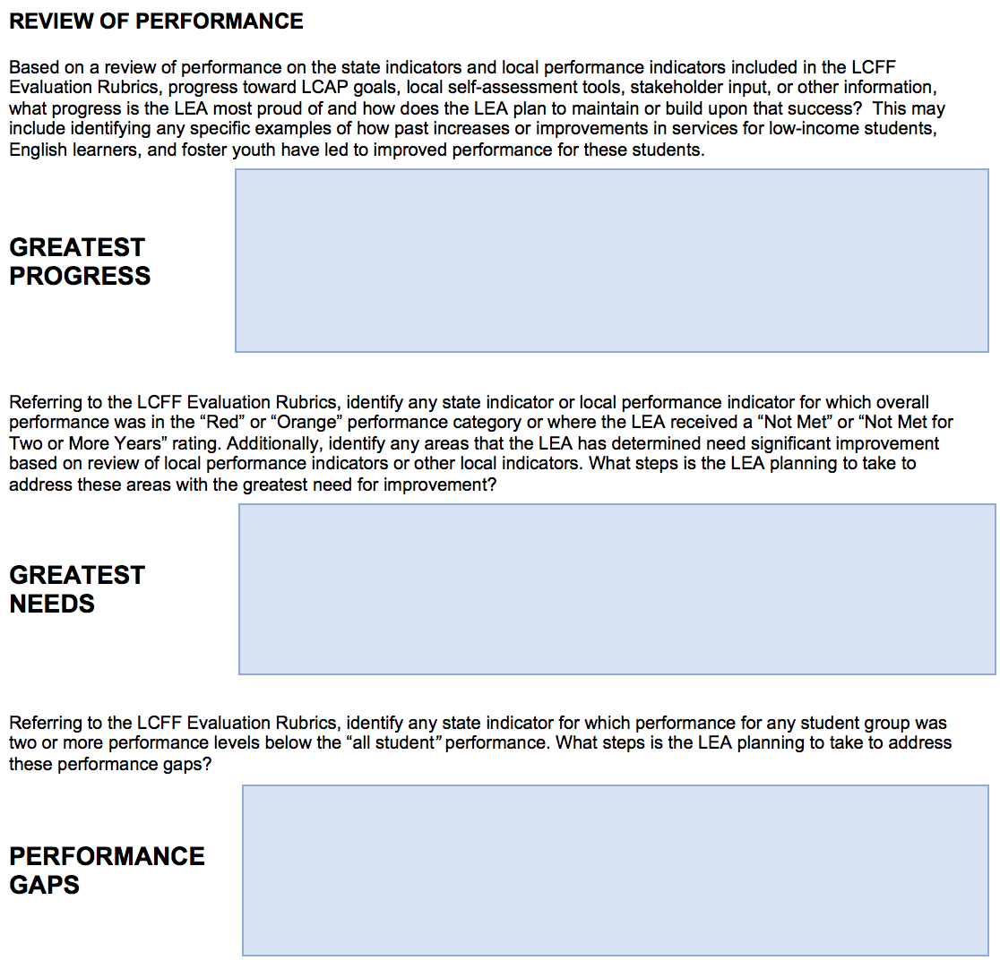
Plan Summary: Summary of Progress (Rubric Link)
2017 CASBO Annual Conference & California School Business Expo
Notes:
In my work with parents, as we were sending drafts back and forth as a “review of performance” they requested a data table to display information regarding progress, needs, and performance gaps. After seeing a data table they asked if a narrative highlighting progress, needs, and gaps was possible as the narrative was felt to be more accessible. Not a surprise, the template developers designed a template that met these needs.

Slide 13
What progress is the LEA most proud of and how does the LEA plan to maintain or build upon that success?
Highlight an area of success or improvement, it may not be a “blue” or “green” area but rather still an area of significant or important improvement
Greatest
Progress
This year the percentage of students that scored a 3 or above on the Advanced Placement (AP) tests rose 5.6% to 61.4%. Additionally the percentage of historically under-represented subgroups enrolled in AP classes and attempting the AP exams rose enough to reflect the demographics of the district, Hispanic/Latino participation rose 18%, and African American participation rose 14%.
Stakeholder input from parents, staff, and students made further reducing class size at high school a priority to support our continued improvement in serving underrepresented students in AP courses. The addition of the Naviance college planning software to our high schools and the growth of our Advancement Via Individual Determination (AVID) program in our middle schools has helped focus students on college readiness. This year we will expand Naviance to middle school to assist students and their families in planning for high school success. See: Goal 1 (pg. 18), Goal 2 (pg. 25), Goal 3 (pg. 31)
See also: “Increased or Improved Services”
2017 CASBO Annual Conference & California School Business Expo
Notes:
This is a two part prompt --- part 1 highlight your greatest progress. And part two is: How will you maintain or build upon that success? (continuous improvement) Because many will not go beyond the summary and for ease of review the Goal and page references of the actions to maintain/improve a
It is important to note that there is flexibility for the LEA, the greatest progress may not be blue or green on the LCFF Rubric- maybe red to yellow is the greatest progress or it may be a local measure.
Based on a review of state and local indicators of student performance included in the LCFF Evaluation Rubrics, local self-assessment tools, stakeholder input, or other information, what progress is the LEA most proud of and how does the LEA plan to maintain or build upon that success?

Slide 14
Refer to the LCFF Evaluation Rubrics, address any performance indicator where overall performance was in the “Red” or “Orange” performance category or received a “Not Met” or “Not Met for Two or More Years” rating. What steps is the LEA planning to take to address these areas with the greatest need for improvement?
Greatest
Need
The district rubric indicator was “yellow” for “all students” based on the 2016 CAASPP Mathematics results. 53% of the district scored standard met or standard exceeded in mathematics. Scores for our unduplicated populations were two performance levels below the below the Asian and White student groups in this measure.
Research is overwhelming that instructor effectiveness is the key to improving outcomes for all students, so the JAUHSD LCAP invests heavily in instructional coaching in content and culturally relevant pedagogy to improve academic outcomes for all students.
LCAP Goal 1
We are also continuing to invest in professional development for teachers regarding implementation of common core curricula and pedagogy.
LCAP Goal 1
We also continue to invest in targeted support and intervention programs to meet the instructional needs of at-risk students at all grade levels.
LCAP Goal 1
Use the rubric and input to identify “most” important need. If no “Red” or “Orange” data points, select area of greatest need with input
2017 CASBO Annual Conference & California School Business Expo
Notes:
Identifying the “Greatest Need” is based on the LCFF Rubric and may include an item that could also be addressed in sections for “increased or improved services” note that in this example there is an overall need and a subgroup need although the subgroup need is not being compared to “ALL Students” but rather to two to of the higher performing subgroups. (remember that subgroups of 30 may be very volatile) Again the steps the LEA is taking our articulated here and referenced to the main body of the LCAP. This provides ease of access for stakeholders or ‘reviewers’ and it provides information and transparency for those that will not go beyond the summary

Slide 15
Referring to the LCFF Evaluation Rubrics, address any state indicator for which performance performance of any group was two or more levels below the “all student” performance. What steps is the LEA planning to take to address these performance gaps.
Performance
Gaps
English learner achievement on CAASPP mathematics and English language arts is two levels below the “all student” performance. To address the gap, JAUSD LCAP includes the following actions and services:
Professional development to improve ELD in content area subjects LCAP Goal 1
Adding classes of ELD content support at middle and high school for EL Level 1 and EL level 2 students LCAP Goal 1
Summer School program with targeted classrooms LCAP Goal 2
Suspension Rate data show that African American and Hispanic/Latino students are two levels below the “all student” performance. To address the gap the following actions and services are included:
Positive Behavior Interventions and Supports will be implemented at all sites LCAP Goal 2
2 Coaches to provide professional development and model an “equity emphasis” and culturally relevant pedagogy LCAP Goal 1
Use the LCFF rubric to identify performance gaps.
2017 CASBO Annual Conference & California School Business Expo
Notes:
In the #11, 12.13

Slide 16
Plan Summary: Increased or Improved Services
Increased or Improved Services
If not previously addressed, identify two or three most significant ways the LEA will increase or improve services
for low income, English learner, or foster youth.
Based on staff and stakeholder feedback and research on effective practices we are implementing more than 20 LCAP Action/Services to improve services for the low income, English learner and foster youth including using a portion of the LCFF Supplemental dollars for site allocations based on the number of unduplicated youth served to allow sites to implement site specific solutions based on unique site needs, and site stakeholder input. Three significant actions to improve services are:
• Providing additional ELD and sheltered content class supports for ELD 1 and 2 students at all middle
and high schools. See LCAP Goal 1
• Additional college and career counseling for the lowest performing schools as well as to
meet the needs of English learner, migrant, low income, foster youth and African American students.
See LCAP Goal 2
• Community Specialist support at all schools with high concentrations of Latino, English learner, and
African American youth. See Goal 3
In many districts this is a section that will be a focal area.
2017 CASBO Annual Conference & California School Business Expo
Notes:
Highlight additional actions and services for unduplicated students if not “previously addressed.” Again the page and goal reference provide transparency and access for those that will go deeper into the LCAP while also providing assurance that unduplicated student needs are being addressed in the LCAP.

Slide 17
Section 1: Plan Summary - Budget Summary
2017 CASBO Annual Conference & California School Business Expo

Slide 18
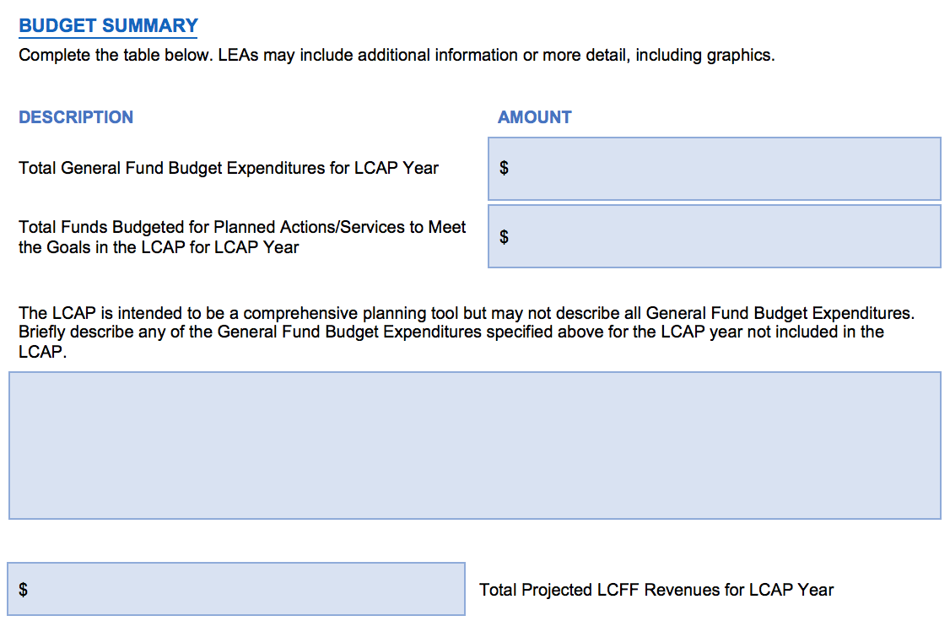
Plan Summary: Budget Summary
2017 CASBO Annual Conference & California School Business Expo

Slide 19
Completing the Budget Summary
Completing the Budget Summary
SACS Form 01
Page 1
9) TOTAL EXPENDITURES
Column (F)
++ Plus ++
Transfers Out
Other Uses
Total $ Budgeted for Actions / Services in LCAP Year (All Sources)
Explain use of funds not included in LCAP Actions / Services
SACS Form 01
Page 4
Subtotal, LCFF Sources
-- Minus --
Transfers to Charter Schools in Lieu Property Taxes
2017 CASBO Annual Conference & California School Business Expo

Slide 20
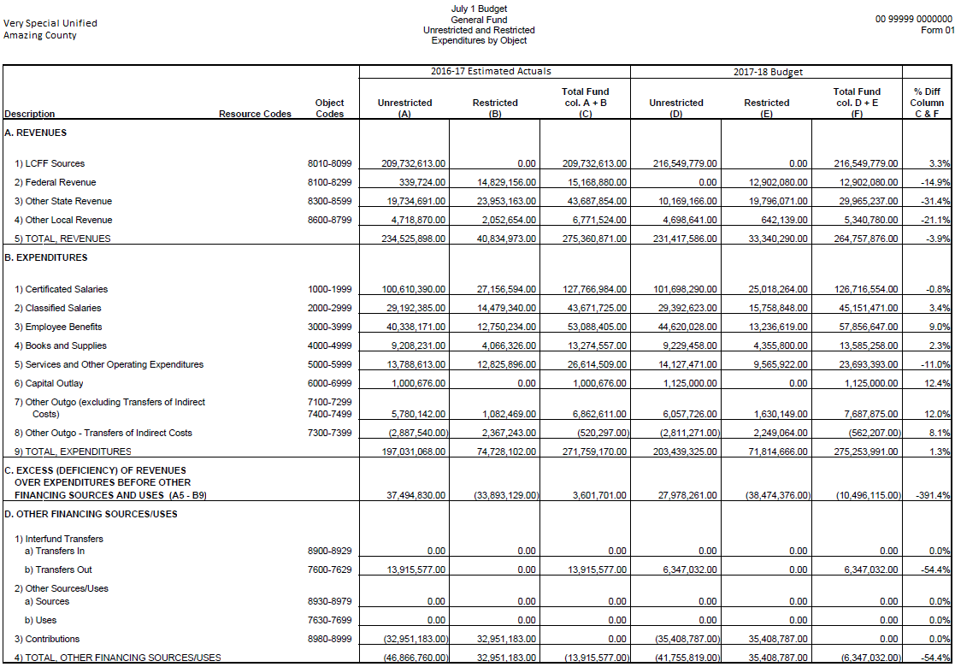
Completing the Budget Summary
Total General Fund Budgeted Expenditures
281,601,023.00
2017 CASBO Annual Conference & California School Business Expo

Slide 21
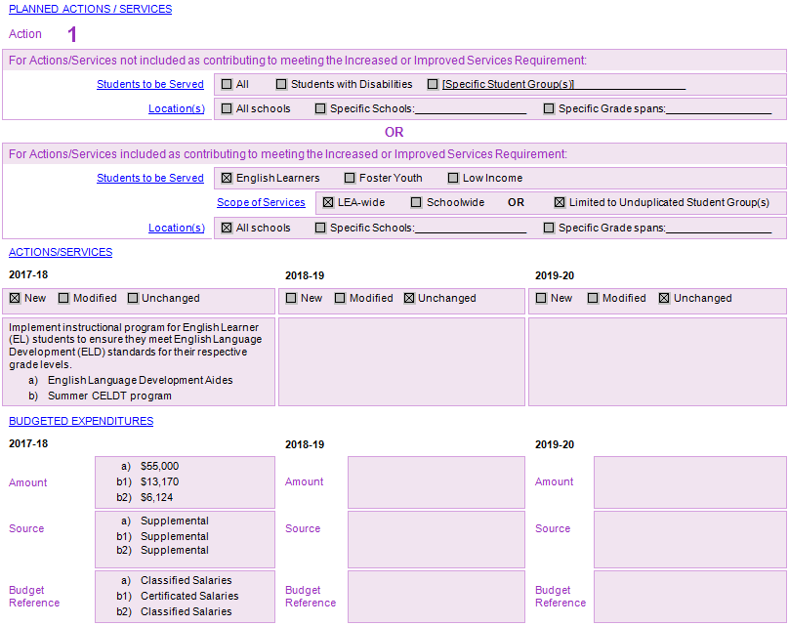
Completing the Budget Summary
Total Funds Budgeted for Planned Actions/Services in LCAP Year
Note:
Total of all amounts budgeted actions/services for 2017
If amounts are duplicated in other Actions/Services, ONLY COUNT ONCE
2017 CASBO Annual Conference & California School Business Expo

Slide 22
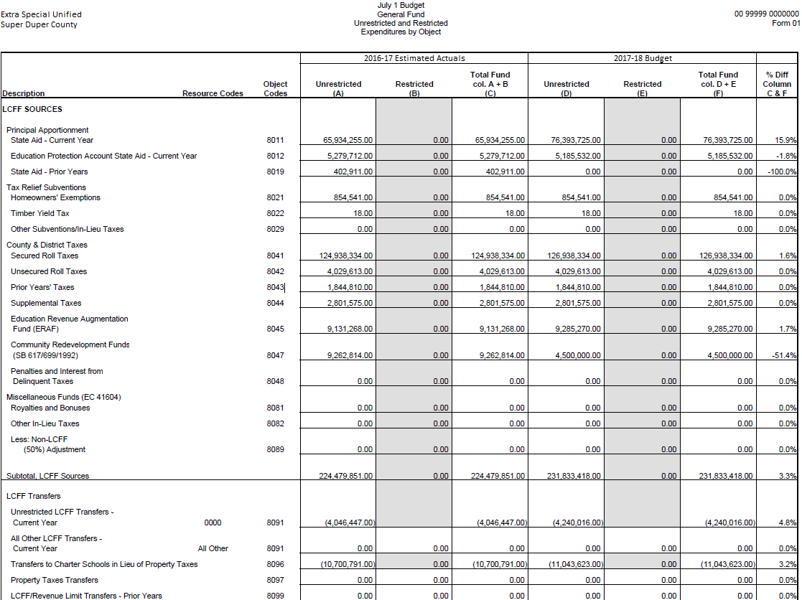
Completing the Budget Summary
Total Projected LCFF Revenues
220,789,795.00
2017 CASBO Annual Conference & California School Business Expo

Slide 23
Completing the Budget Summary
Description of Budgeted Expenditures Not Included in LCAP
Potential Items to Include in Brief Description
Cost of base program
General cost of overhead
Contributions to program not included in LCAP
Mandatory contributions to Routine Restricted Maintenance
Anything else that might:
a) Help stakeholders understand overall cost of education
b) Be useful for district to share
Could be opportunity rather than challenge
Merriam-Webster Definition
Brief: using only a few words
2017 CASBO Annual Conference & California School Business Expo

Slide 24
Best Practices - Use of Funds
Meets Basic Requirements
Short description statements, general dollar figures
Teacher, staff, and administrator salary and benefits account for nearly 90% of the district’s general fund expenditures (roughly $90 million). Other key expenditures include general overhead($1 million) expenses, transportation ($800 thousand), maintenance ($4 million), and contributions to special education ($4 million).
Exceptional LCAP Communication
Informative statements which are helpful to stakeholders
The district strives to implement its strategic vision toward improving student outcomes while maintaining fiscal responsibility. An overwhelming majority of district expenditures (88%) are used to hire teachers and staff who deliver services to students. LCAP initiatives account for only $3.5 million of overall cost of salaries and benefits ($88 million). The district is facing increased costs related to pensions (increasing $1.3 million per year), persistent underfunding of our special education program ($16 million), and ...
What to Avoid
A spreadsheet of numbers with no context

Slide 25
Section 2: Annual Update
2017 CASBO Annual Conference & California School Business Expo

Slide 26
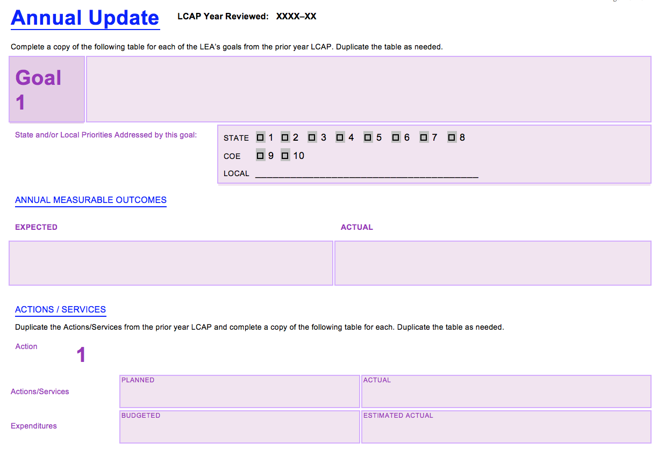
2017 CASBO Annual Conference & California School Business Expo
Notes:
This next section will spotlight the Annual Update. Take a minute to read this excerpt. The Annual Update has now been moved after the Summary pages. The political context as displayed speaks to the fundamental purpose of the Annual Update. With the addition of the Evaluation Rubrics, now is the time to focus attention on the Annual Update to make sure it moves from a missed opportunity to a real opportunity for continuous improvement.

Slide 27
2017 CASBO Annual Conference & California School Business Expo
Notes:
We will be taking a closer look at the additional Analysis questions in a few minutes.

Slide 28
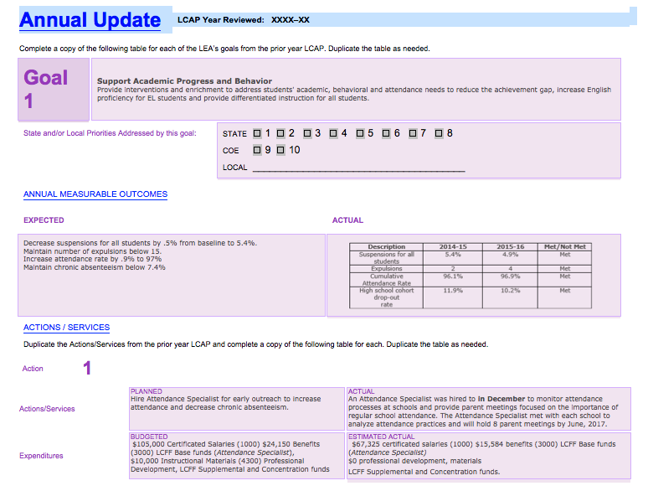
Copied Verbatim
Copied Verbatim
Use most current data
Identify the actual actions/services, including changes
Copied Verbatim
Identify fiscal projections through 6/30
Notes:
Introduce the new template format, emphasizing areas to be copied verbatim. Provide year of data for outcomes. Changes to students, students groups served, planned location of services...

Slide 29
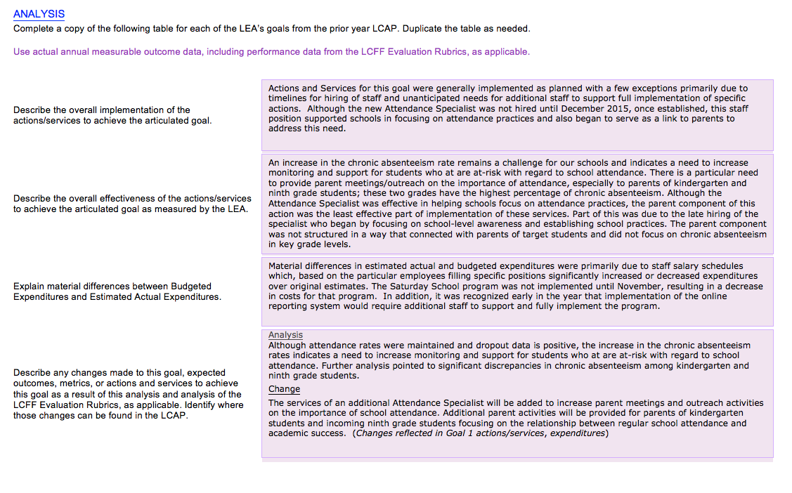
Complete a table for each of the LEA’s goals from the prior year.
Use actual measurable outcome data, including performance data from Evaluation Rubrics
Notes:
The instructions state that districts and COEs will need to complete a table for each of the LEA’s goals from the prior year and use actual measurable outcome data, INCLUDING data from Evaluation Rubrics. This section of the template has been changed significantly. In the previous LCAP, we had one question “What changes in actions, services, and expenditures will be made as a result of reviewing past progress and/or changes to goals?” There are now four questions that districts and COEs will respond to.

Slide 30
Annual Update: District Considerations
Is Analysis based on instructions:
Describes the overall implementation of Actions/Services
Are the challenges/successes in implementation described?
Does the summary directly relate to the goal?
Describes effectiveness of Actions/Services
What criteria are used to determine effectiveness of Actions/Services?
Are these aligned to the goal?
Describes material changes in the budget
Is there a description of material differences in budgeted and actual expenditures?
Is the description presented in a clear and transparent manner?
2017 CASBO Annual Conference & California School Business Expo
Notes:
When working with districts, it is important to ensure districts are reflecting on the overall implementation of Actions/Services including challenges and successes. Is the summary related to the Goal.
Does the district describe the effectiveness of the Actions/Services and use criteria aligned to the Goal.
Does the district describe material differences in the budget clearly and transparently.

Slide 31
Annual Update: District Considerations
Is Analysis based on instructions:
Describes changes to the LCAP for the upcoming year
Are changes based on Analysis of effectiveness of the actions/services in meeting outcomes?
Does the Analysis include data from local indicators and Evaluation Rubrics?
Identifies where changes can be found in the LCAP
Can stakeholders easily locate changes in LCAP?
2017 CASBO Annual Conference & California School Business Expo
Notes:
Does the district describe changes based on the analysis of the Actions/Services? Are local indicators and data from Evaluation Rubrics used to describe any changes to the LCAP?

Slide 32
Example: Analysis
Implementation:
Degree of implementation of key actions/services described
Data included on impact of actions (eg: 50 students on track for graduation)
Reasons for changes are identified (eg: late hiring of staff, increased demands for training)
2017 CASBO Annual Conference & California School Business Expo
Notes:
Providing information on the degree to which actions/services are implemented provides stakeholders with a picture of how the district is moving forward with implementation of the planned actions. It also helps identify challenges to implementation that may need to be addressed. PILOT REPORTING SYSTEM FULLY IMPLEMENTED. ATTENDANCE SPECIALIST HIRED LATE. PD EXPANDED DUE TO INCREASED INTEREST.
Providing data on the impact of the actions provides evidence of the effectiveness of the actions/services.
Identifying the reasons for any changes in implementation provides stakeholders with the information they need to understand the reasoning behind any changes.

Slide 33
Example: Actions/Services
Effectiveness of Actions/Services in Achieving Goal:
Impact of actions/services reveals differences in effectiveness for various groups. (eg: suspensions generally down, but increased for high school; chronic absenteeism impacting kdg and 9th grade)
Effectiveness of actions/services includes analysis of specific components of the action. (eg: attendance specialist services effective in supporting schools, but late hiring and structure for engagement led to less effective outcomes for parent support)
Possible reasons for impact identified by stakeholders are noted. (eg: need for alternatives to suspension for high schools, structure of parent outreach)
2017 CASBO Annual Conference & California School Business Expo
Notes:
Effectiveness is considered in light of impact on all student groups.
Actions often include multiple components. It is important to analyze which aspects of a particular action are more or less effective.
Determination of effectiveness of actions includes data and perceptions from stakeholders. Enthusiasm for or lack of support for an action can impact the degree and effectiveness of implementation.

Slide 34
Example: Budgeted and Actual Expenditures
Changes in expenditures are clearly explained based on implementation of the actions/services (eg: salary costs dependent on who filled positions; impact of late implementation of program; need for additional staff support to effectively implement the program)
2017 CASBO Annual Conference & California School Business Expo
Notes:
If this has been addressed in the information provided in the previous section, it should be an easier task to summarize significant budget changes in this section inrelation to the degree of implementation.

Slide 35
Example - Analysis and Changes
Analysis is clearly described in a transparent and comprehensible manner
Analysis includes review of multiple data sources including Evaluation Rubric and local indicators
Changes are directly tied to analysis of outcomes
Changes are included that demonstrate and attempt to better measure effectiveness of services for specific groups identified as performing below the overall district level
Clearly identifies specific changes and where they can be found in the new LCAP
2017 CASBO Annual Conference & California School Business Expo
Notes:
In this example the analysis is described separately from the changes. This allows stakeholders to see the reasoning behind any changes going forward.
Analysis should show that multiple data sources were included in decision making resulting in a more robust and thoughtful analysis.
It is easy to see how the changes for the coming year are related to the analysis. The link between the analysis and the changes makes the reasoning clear to stakeholders. SUSPENSION RATES ANALYZED BY GRADE SPAN AND STUDENT GROUPS (HS/LOW INCOME); CHRONIC ABSENTEEISM IN KDG AND 9TH GRADE
We usually think of changes in terms of changes to actions in the plan, however, in this example, the analysis identified groups of students for whom there was a need for greater focus so the district determined that additional outcomes should be added to better track the progress of these students. OUTCOMES ADDED FOR HS SUSPENSION RATES AND SUMMER SCHOOL PROGRAM
Clearly describes what the changes are and where they can be found in the revised plan.

Slide 36
Section 3: Stakeholder Engagement
2017 CASBO Annual Conference & California School Business Expo

Slide 37
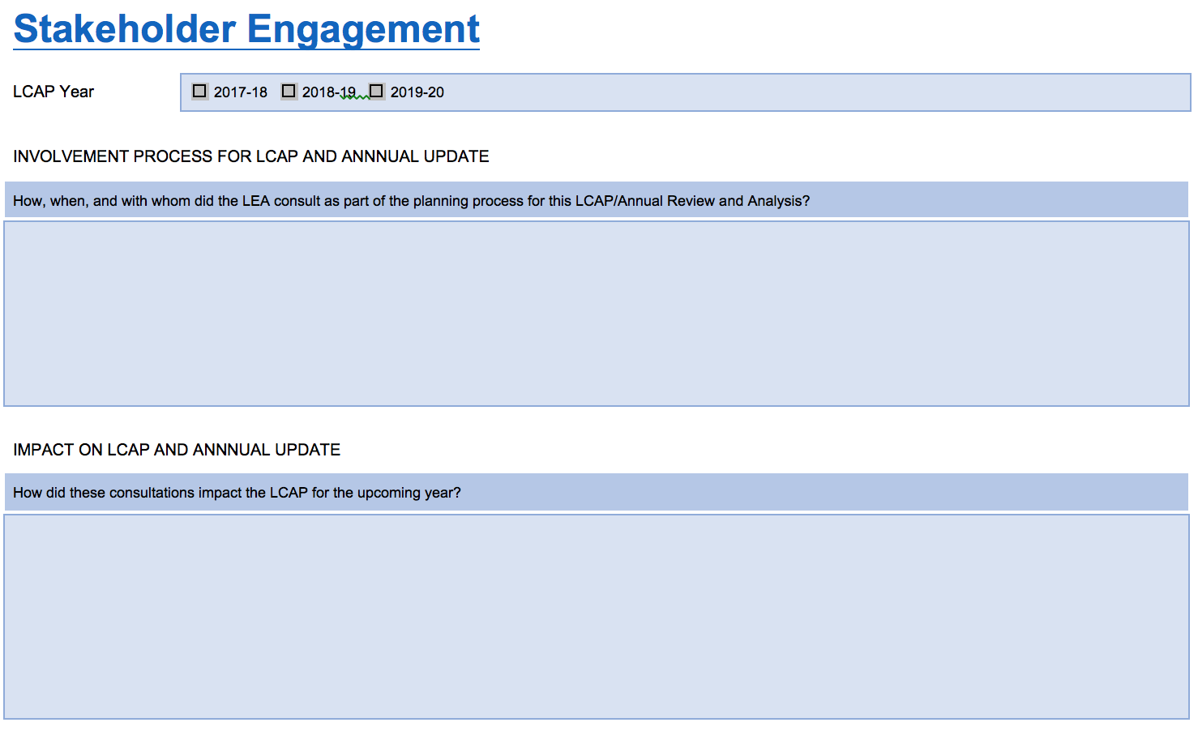
Stakeholder Engagement
2017 CASBO Annual Conference & California School Business Expo
Notes:
Be sure to check the year of LCAP in the header, include all elements asked for in the instructions for each box and specifically how feedback led to changes in the bottom box...more about this is coming in later slides.

Slide 38
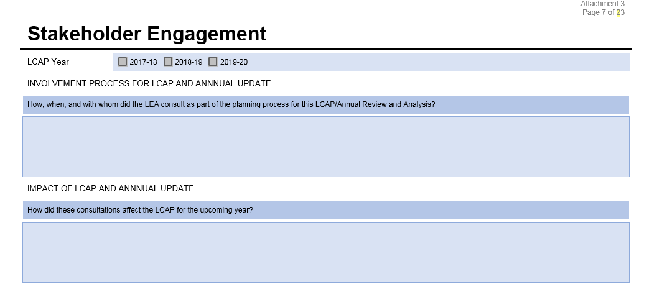
Stakeholder Engagement Template Instructions
Describe the consultation process and how it impacted the development of the LCAP and annual update for the indicated LCAP year, including the goals, actions, services, and expenditures. It is important to note what, if any, specific data was shared with stakeholders during these consultations.
INVOLVEMENT PROCESS FOR LCAP AND ANNUAL UPDATE
Include format or meeting, date, audience/participants for all efforts to gather stakeholder input
Example:
1. On November 30, 2016 COE staff met with Foster Youth Liaisons to gather input on how they perceive COE’s efforts to coordinate services for FY countywide. COE shared data related to the number of meetings held and the contents of its web site.
IMPACT ON LCAP AND ANNUAL UPDATE
1. As a result of its November 30, 2016 meeting with Foster Youth Liaisons it was agreed that:
A. COE would hold monthly collaborative meetings with Liaisons to better track progress and share information in a more timely manner.
B. COE would publish information on its web page related to transportation options available to Foster Youth
50

Slide 39
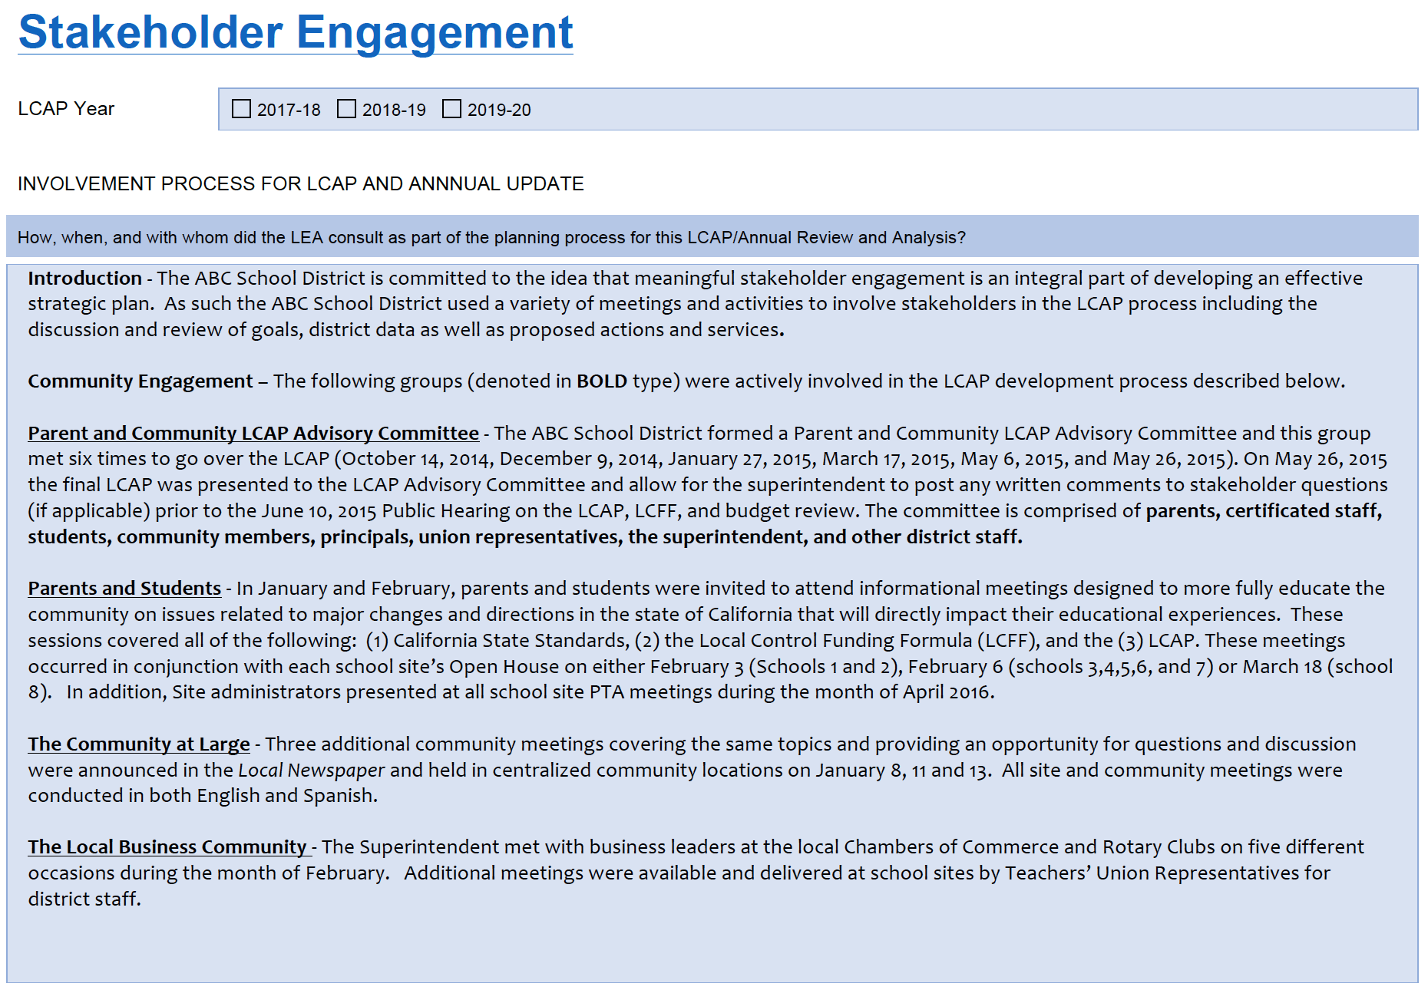
District Example
Notes:
Pass out District Exemplar as well.

Slide 40
LCAP - Example Characteristics
What makes these examples so effective?
An introductory paragraph giving context to the dynamics of the how and why of your process
A clear breakdown and specific names of the constituency groups with whom you met
Specific descriptions of the forums you held, including specific dates
A timeline for your process
Detailed data including the number of respondents and what they advocated for
An historical context or summary as compared to prior years
A detailed description of how this input directly impacted your LCAP including specific goals, actions and services that were added, modified or deleted.
Notes:
Conversely, what CDE has noticed is that some LCAPs don’t list specific dates, don’t make a direct connection between the feedback received and where the resulting changes can be found in the LCAP, ie Which Goal, Action or service...

Slide 41
Section 4: Goals, Actions, and Services
2017 CASBO Annual Conference & California School Business Expo

Slide 42
Notes:
While much has changed in the new template there is much that is the same.

Slide 43
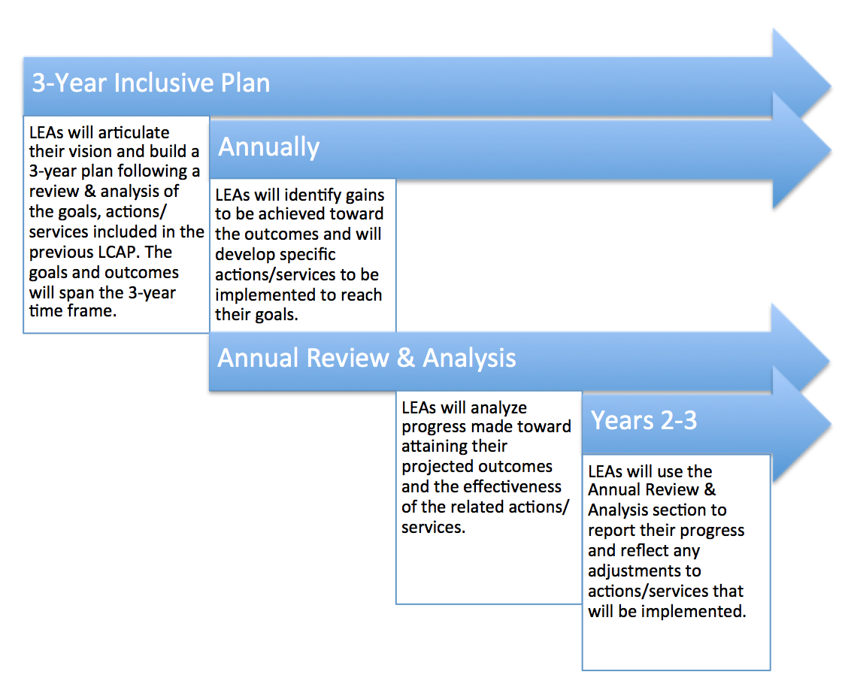
Changes in Expectations
by Year
Notes:
Annual review and annual adjustments foster continuous improvement

Slide 44
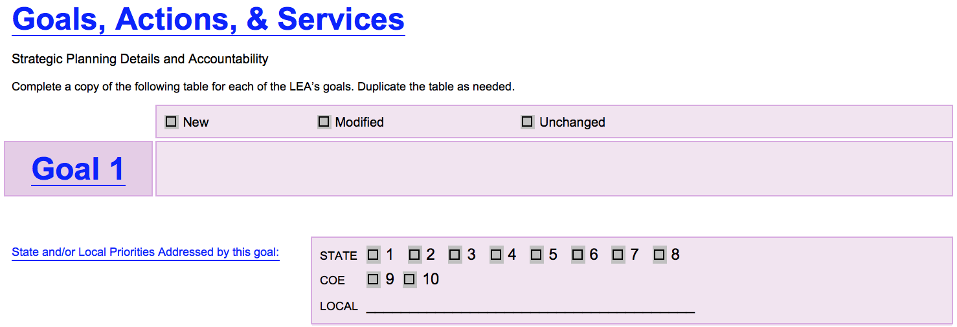
Revised LCAP Template
New

Slide 45
Revised LCAP Template
Separate locations to include information
Notes:
This will be very helpful for LCAPers to utilize the Rubrics and local measures and set meaningful achievement targets

Slide 46
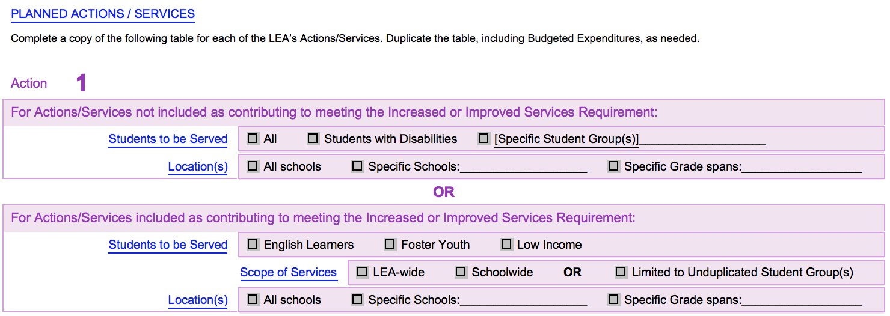
Revised LCAP Template
New Component

Slide 47
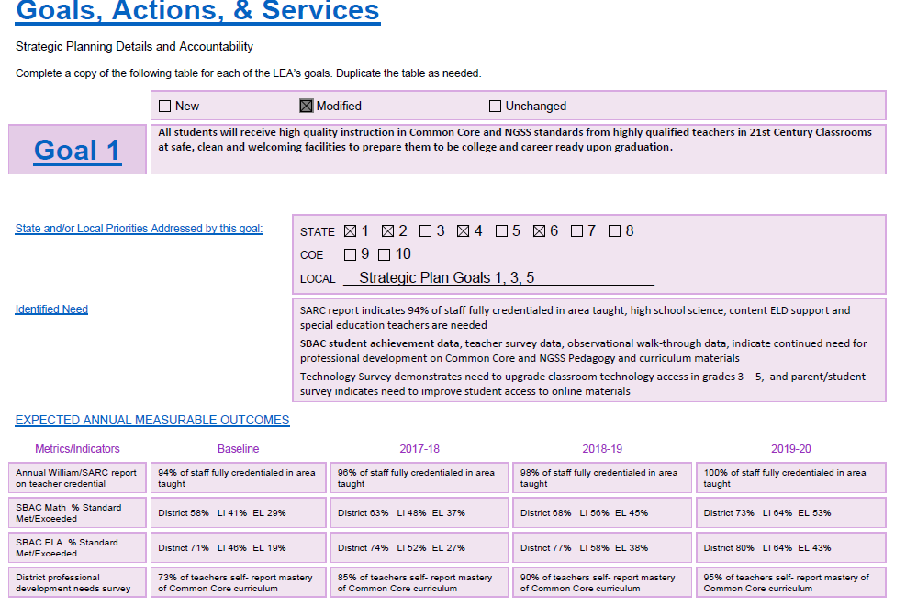
Goals, Actions, and Services Example
This goal covers basic services, teachers, curriculum, and facilities
All students will receive high quality instruction in California English language arts, mathematics and Next Generation Science Standards (NGSS) from highly qualified teachers in 21st Century classrooms at safe clean and welcoming facilities to prepare them to be college and career ready upon graduation.
Use of state and local metrics and inclusion of needs as identified by a variety of stakeholders
Measures include closing of the gap
73% of teachers self-report mastery of California Standards Curriculum on
85% of teachers will self-report mastery of California Standards Curriculum
90% of teachers will self-report mastery of California Standards Curriculum
95% of teachers will self-report mastery of California Standards Curriculum
2017 CASBO Annual Conference & California School Business Expo
Notes:
This goal was adapted from a 2016 LCAP -- it is important to make the metrics and indicators meaningful towards closing performance gaps. The LCFF Rubric is a starting point for the discussions that should take place in identifying the goals actions and services to be provided. This LCAP provided multiple state and local measures to address progress

Slide 48
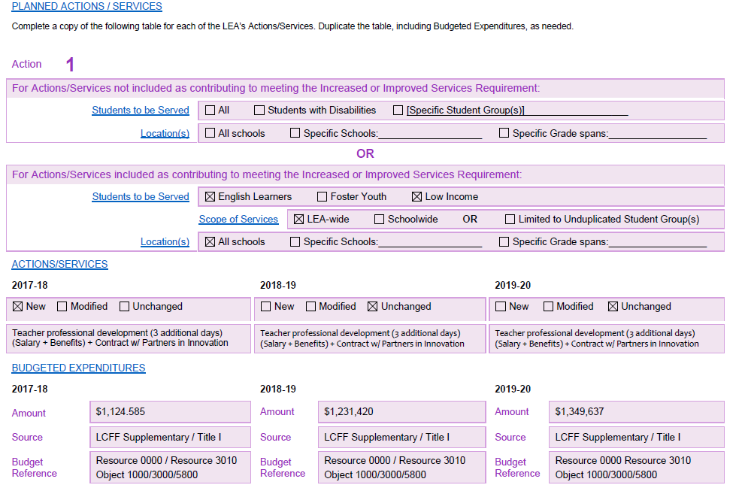
Goals, Actions, and Services Example
Action may seem to serve all but be “principally directed” to meet subgroup needs
and Professional Development contract
and Professional Development contract
and Professional Development contract
Show increased costs and other funding sources
LCFF Supplemental / Title I
LCFF Supplemental / Title I
LCFF Supplemental / Title I
2017 CASBO Annual Conference & California School Business Expo
Notes:
Goal 1 Action 2 - while some targeted actions such as an “intervention class” for students reading 2 or more grade levels below standard are targeted services clearly designed to meet subgroups needs, actions or services meant to improve the overall instructional program in order to improve student outcomes may be “principally directed” to meet the needs of unduplicated or other subgroup youth

Slide 49
Revised LCAP Template
New

Slide 50
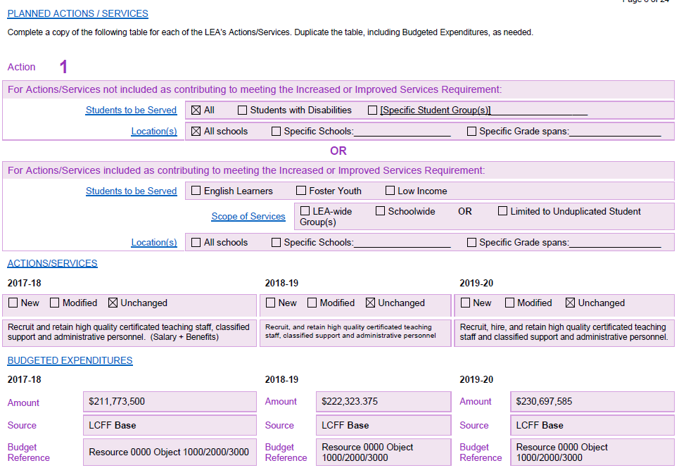
Goals, Actions, and Services Example
Important to show increased costs and base services
2017 CASBO Annual Conference & California School Business Expo
Notes:
This was also adapted from a district 2016 LCAP/Budget
Because the goal incorporated base services for all students the first action address the first - qualified staff - because salaries and benefits are the vast majority of a district’s costs it is also a means to produce a “comprehensive plan” It is very important that the LEA team is working together. When costs are going up over the 3 years of the plan how is the LEA preparing to incorporate the increased cost projections while improving services. The LCAP is not a wish list. Much planning and thought must go into deciding which actions and services will lead to improved outcomes and can be sustained as needed. Thoughtful planning is a must and it is important to make sure stakeholders are included in discussions and clear expectations of the LCAP are provided for them

Slide 51
Goals, Actions, and Services
Does the Goal address at least one of the State Priorities?
Who is served by the action or service?
Does the action/service provide a targeted service or is it principally directed to improve unduplicated outcomes through broad instructional or service improvements?
What state and local metrics will be used to measure continuous improvement?
Are the metrics differentiated to address performance gaps?
2017 CASBO Annual Conference & California School Business Expo

Slide 52
Goals, Actions, and Services: Outcomes
Provide measurable outcomes
“Identify and describe specific expected measurable outcomes”
Provide outcomes for all metrics for all 3 years
“…the goal tables must address all required metrics for every state priority in each LCAP year”
Break out expenditures by fund source
“What changes to goals, actions, services, and expenditures are being made in the LCAP”
2017 CASBO Annual Conference & California School Business Expo
Notes:
Breaking out the expenditures is important for the budget link as well as transparency for stakeholders

Slide 53
Section 5: Demonstration of Increased or Improved Services for Unduplicated Pupils
2017 CASBO Annual Conference & California School Business Expo

Slide 54
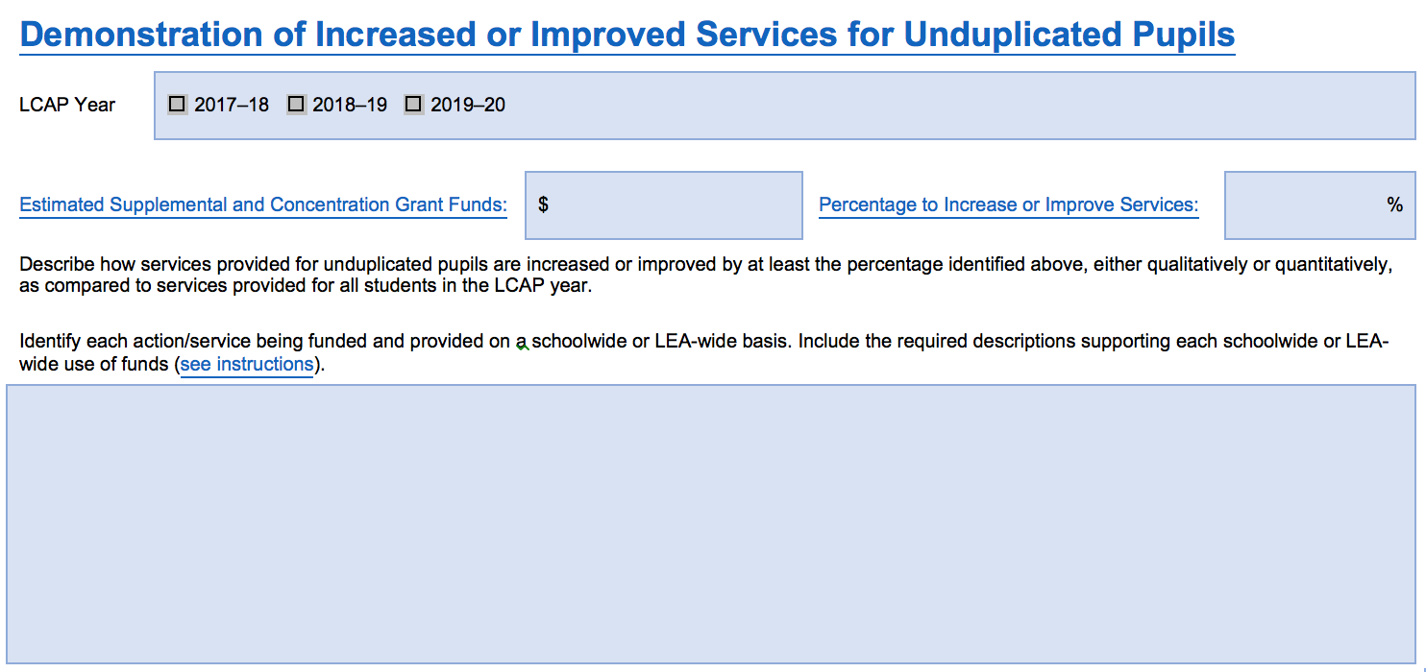
Demonstration of Increased or Improved Services for Unduplicated Pupils
2017 CASBO Annual Conference & California School Business Expo

Slide 55
Demonstration of Increased or Improved Services for Unduplicated Pupils: Starting Point
What to do before completing section
Use FCMAT LCFF Calculator to calculate estimated Supplemental and Concentration Grant Funds and Minimum Proportionality Percentage (MPP) for LCAP year
Review Goals, Actions, and Services section (after completed)
Identify goals identified as contributing toward increased or improved services
Identify any use of Supplemental and Concentration Grant funds and whether the use was:
District-wide
School-wide
Targeted Services
Obtain unduplicated pupil percentages for district and each school site
Assemble information related to research-based strategies implemented at district and/or school sites
2017 CASBO Annual Conference & California School Business Expo

Slide 56
Completing the Demonstration of Increased or Improved Services for Unduplicated Pupils
FCMAT LCFF Calculator
LCAP MPP Tab
5. Estimated Supplemental & Concentration Grant Funding
2017-18 Column
FCMAT LCFF Calculator
LCAP MPP Tab
7/8. Minimum Proportionality Percentage
2017-18 Column
2017 CASBO Annual Conference & California School Business Expo

Slide 57
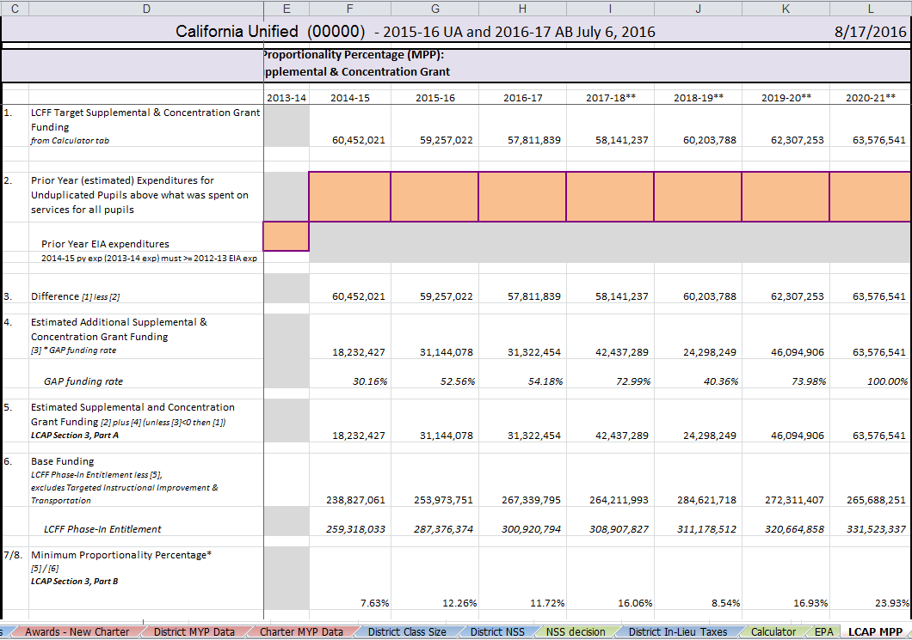
Completing the Demonstration of Increased or Improved Services for Unduplicated Pupils
2017 CASBO Annual Conference & California School Business Expo

Slide 58
Completing the Demonstration of Increased or Improved Services for Unduplicated Pupils
42,437,289
16.06
2017 CASBO Annual Conference & California School Business Expo

Slide 59
Demonstration of Increased or Improved Services for Unduplicated Pupils: Instructions
Description requirements for Action(s)/Service(s) provided LEA-wide or Schoolwide:
Template Instructions
LEA-wide
Schoolwide
Principally directed to unduplicated pupils
55% or More Unduplicated Pupils
40% or More Unduplicated Pupils
Effective in meeting goals for unduplicated pupils
Less than 55% Unduplicated Pupils
Most effective use of the funds
Basis for determination
Alternatives considered
Supporting research, experience, or educational theory
Less than 40% Unduplicated Pupils
2017 CASBO Annual Conference & California School Business Expo

Slide 60
Demonstration of Increased or Improved Services for Unduplicated Pupils
What % of supplemental and concentration funds to be included?
“Describe how the LEA is expending the Supplemental and Concentration Grant Funds this LCAP year.”
“Demonstrate how the services provided in the LCAP year for low income pupils, foster youth, and English learners provide for increased or improved services for these pupils in proportion to the increase in funding provided for such pupils in that year.”
What % of LCFF funding should be addressed?
“The LCAP is intended to be a comprehensive planning tool. Accordingly, in developing goals, specific actions, and expenditures, LEAs should carefully consider how to reflect the services and related expenses for their basic instructional program in relationship to the state priorities.”
2017 CASBO Annual Conference & California School Business Expo

Slide 61
Questions?
CASBO disclaimer included
“These materials have been prepared by the CASBO Financial Services Professional Council (or CASBO Associate Member). They have not been reviewed by State CASBO for approval, so therefore are not an official statement of CASBO.”

